Slide 1



Using Artificial Intelligence in Learning
A beloved child has many names – artificial intelligence, synthetic mind, kratt, AI, etc..
pp.kk.aaaa
Notes:
Artificial intelligence, which can be called by many different names in Estonia, is used at the university to enhance teaching and research.
Let’s look together at how and from whom you can get the necessary information, and how we as a university use it.

Slide 2
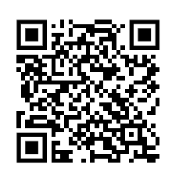
Use of Artificial Intelligence in Teaching
Rules and recommendations regarding AI can be found under good practices::
https://taltech.ee/en/student/academic-information/good-practices
Permitted uses:
As a source of inspiration
For evaluating and refining your own thoughts and ideas
In the final stage of work
For translation and learning support in early stages of work
For text editing
Prohibited uses:
For composing large portions of thesis text
For fabricating data to be analyzed in the work
For composing substantive arguments
The student is responsible for the content and quality of the thesis, regardless of the sources used, including artificial intelligence.
TALLINNA TEHNIKAÜLIKOOL
Notes:
The university has centrally established good practices for using AI.
From this link (please open on your mobile), you can see all the good practices.
Select “Guidelines for Using Artificial Intelligence in Teaching.”
In summary, there are general agreements on how to use AI correctly.
In all actions involving AI, the responsible party is the human. We do not accept excuses like “AI did it.” AI does nothing independently. A person used it, therefore the person is responsible.

Slide 3
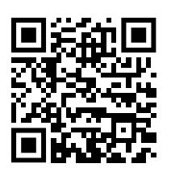
University Rules and Course for Students
Program directors and lecturers provide an overview of using AI in teaching.
Program directors give examples of good and bad AI usage.
Lecturers inform students how AI-based software is allowed in their course.
A supporting e-course for students has been created (currenlty EST)
https://moodle.taltech.ee/course/view.php?id=35369
Notes:
Lecturers decide on AI usage in their course.
So pay close attention to what your program directors and lecturers say about AI usage.
Lecturers decide how much and in what way AI is allowed or not allowed in their course. You’ll find this information in the extended course description or in specific rules for each assignment. Please follow these rules.
We have also created a central e-course to help students, which provides an overview of:
What AI is
How to prompt better
Examples of different apps used in teaching
What is good and bad AI usage
AI ethics and each person’s responsibility in using it
We expect each of you to complete this e-course before the start of the academic year. The course is interesting and eye-opening.

Slide 4
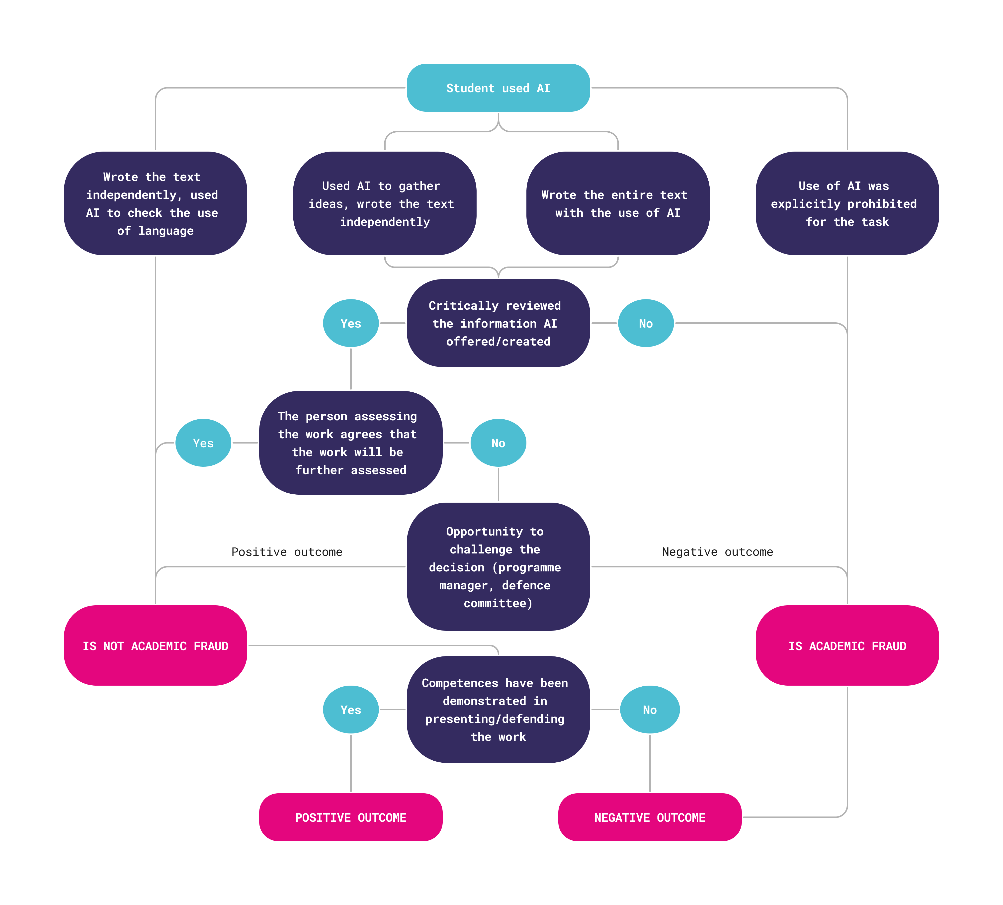
AI Usage – Allowed or Prohibited?
Here is a diagram that simplifies understanding whether AI is allowed or not.
Case 1: Student used AI – copied 1:1 and submitted the work to the lecturer. The content was correct, but...
Case 2: Student created the base themselves, used AI for grammar corrections, and submitted the work. AI usage was not allowed in the course.
Notes:
The university has created a block diagram to help answer whether AI usage is allowed.
It is very important to find out what the evaluator (e.g., lecturer) has allowed or not.
If no restrictions are mentioned, you cannot assume AI usage is allowed. In that case, ask the lecturer.
Although the university allows AI for idea generation and language improvement, usage must be clarified in the context of the specific course.
For example, Case 1: The text is correct, but since it was not created by the student, it is direct academic fraud.
Who is being deceived? Yourself – because the student who acted this way will not acquire the necessary competencies needed for future tasks and work.
Initially, it may seem like time is saved, but that time is saved at the expense of personal development.
If a person does not acquire the necessary knowledge, such tasks will likely be taken over by AI in the future.
For example, Case 2: Even though the student did the work themselves, AI usage was prohibited in that assignment.
So it is very important that even the most boring tasks should be done independently and not with AI help – lecturers know best how you can acquire knowledge and create necessary connections in your brain.
AI may give quick results or seemingly polished text, but no learning occurs.
I believe you all understand how important it is to develop your brain, because you have enrolled in university.
So resist the pressure to secretly use AI in assignments if you know it is prohibited.
Restrictions on AI usage exist for a reason – so you learn to create text independently from scratch.
Does anyone have an example of a case we could try to solve using this diagram?

Slide 5
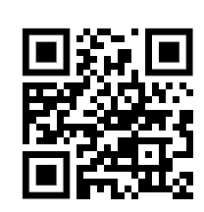
Support for AI Usage in Written Work
Library opening hours:
Mon–Fri 8:30–20:00
Sat 10:00–17:00
EMERA branch (Kopli 101):
Mon–Thu 9:00–17:00, Fri 9:00–14:00
We welcome you to visit!!
There are many questions:
How to use AI assistance in academic writing?
Can I use AI to improve text quality?
How to cite correctly?
Is AI even suitable as a source?
What should I know about personal data protection?
Can I input my collected research results into AI?
Library specialists also support academic AI usage:
https://taltech.ee/en/library
In November, the library hosts “Thesis Week.”
Notes:
In addition to lecturers, program directors, potential thesis supervisors, and the created e-course, our knowledgeable library specialists also offer help.
They know and advise you on how to write the best thesis or find the best academic sources.
Our library’s online scientific databases are powerful – use them for learning and thesis writing.
We have planned trainings and events in November on how to use AI in theses.
If you need help earlier, participate in consultations or other courses offered by the library.
Academic writing is not as simple as compiling a report with AI, which you may have encountered in earlier education levels.
At university, we expect students to express their thoughts and ideas in academic language.
This must be learned and practiced to achieve the best result.
You’ll get help from your lecturers, but we also strongly recommend using the library’s support.
Visit today – then the path will be familiar.
For example, take a selfie with your new friends in the beautiful green corner on the second floor of the library, with books in the background!
You’ll also get a few steps in for your health. :)

Slide 6
AI and Citation in Academic Work (Briefly)
If the output from an application is used substantively (e.g., text excerpt, image), the application must be cited as a method.
For extensive use, describe the AI usage and tools in the methodology or introduction.
The description must explain the extent and manner of AI usage.
If AI is used as a tool (e.g., text editing, translation), citation is not necessary.
AI is not suitable as an independent source. The student must cite human-created original sources, except when the purpose of the work is to study AI usage
Notes:
Summary of key principles important in every academic work:
If AI is used as a source of inspiration, for evaluating and refining ideas, for translation and learning support in early stages, or for text editing in final stages, this must be clearly stated in the work.
The description of AI usage must be included in the methodology or introduction.
The description must explain the extent and manner of AI usage.
AI is not a valid source – it is not academic, human, or legal, and cannot be cited.
AI can only be cited if the work investigates AI usage – e.g., which AI tool is best for analysis, programming, or detection.

Slide 7
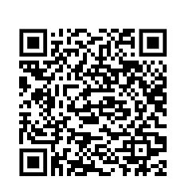
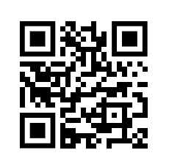
Security and Data Protection
The student is responsible for the accuracy, quality, and security of submitted information, research material, and analysis results.
It is permitted to use AI technologies that comply with data protection and cybersecurity requirements. More information is available in the university’s document on personal data processing and protection:
https://oigusaktid.taltech.ee/en/procedure-for-processing-and-protection-of-personal-data/
Additionally, we recommend reviewing (EST)
https://intellektuaalomand.ee
Notes:
Besides knowing how to use AI tools academically, it is also important to know when to use them.
First, we must understand that any AI tool takes your input as its own – even if it promises not to use it for training, you may accidentally violate personal data, copyright, or intellectual property laws.
You cannot input someone else’s name or work into AI without that person’s explicit permission (e.g., written consent).
So think carefully: if you input your analysis data, someone’s article, or someone’s name into AI, what consequences might arise if it comes out years later (e.g., someone sues you or you get fined)?
Today, people mistakenly believe that everything entered into AI remains hidden. In reality, it does not.
All actions are logged and saved.
Many AI platforms have already started checking whether the input may contain someone else’s intellectual property.
You can review the university’s personal data protection policy via the link and QR code – it applies to you too.
We also recommend reviewing online resources about intellectual property to better understand the rights of other authors and creators.
This topic is also covered in more detail in the student e-course – please complete it as soon as possible.

Slide 8
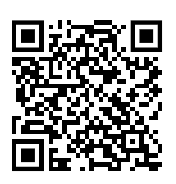
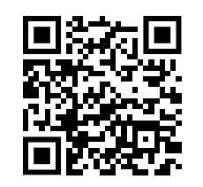
Student’s Academic Responsibility in Learning
The student is responsible for following academic good practices and avoiding academic dishonesty – such as plagiarism, submitting AI-generated work without permission, presenting false data, or submitting someone else’s work under their own name.
Consequences for the student may include:
Unsatisfactory grade
Prohibition from resubmitting the work
Expulsion for repeated or severe violations
A note of academic dishonesty as a reprimand
The student is obligated to familiarize themselves with and follow the lecturer’s, course’s, and university’s academic integrity principles, including the permitted extent of AI usage.
Good practices at the university – also review other practices such as academic ethics:
https://taltech.ee/en/student/academic-information/good-practices
Also review TalTech’s study regulations:
https://oigusaktid.taltech.ee/en/academic-policies/
Notes:
It is very important that everyone understands their rights and responsibilities in their work – especially you as students.
All lecturers expect that you have come here to learn and truly acquire competencies.
AI may help in difficult situations, but not always.
Therefore, we must also talk about situations where academic good practice has been violated and punishment follows.
In severe cases, punishment at the university includes both reprimand and expulsion.

Slide 9
University’s Responsibility in Teaching
The lecturer is responsible for giving clear instructions:
What is allowed and what is not (e.g., whether AI may be used and in which parts), what are the requirements for submitting and citing work.
For guiding the student to understand the boundaries of academic integrity and AI usage.
For monitoring compliance with rules, including:
Detecting suspicious work (plagiarism detection, other academic violations), documenting violations, and initiating reprimands if necessary.
The lecturer may conduct additional checks to verify acquired competencies – e.g., ask to redo the work in class, ask for oral explanations of the topic.
The university’s responsibility in the context of academic dishonesty and excessive AI use includes:
Clear rules on academic integrity and AI usage
Informing and training students and lecturers
Providing tools and guidelines to prevent and detect dishonesty
Fair and transparent procedures in case of violations
A learning environment that supports honesty and encourages meaningful learning
Notes:
In summary, the university is responsible for ensuring everyone knows how to act with academic integrity.
We offer you guidelines and necessary training.
We also provide various tools for lecturers to ensure that each student acquires the required competencies in their course.
Therefore, it is very important that when a lecturer conducts an assessment, it must be based on your proven competencies.
It is completely normal that, in addition to submitted work, random checks are conducted where you need to explain or redo your work.
This is not harassment by the lecturer – it is their duty to ensure that everyone has acquired the necessary competencies.
This may mean that some must prove their competencies more than others – this is also normal and not a violation of academic practices or discrimination.
If you have acquired the competencies, no one has reason to refuse to prove them.
That is your task as students – to demonstrate your skills, and we will help you improve your knowledge in the best way.

