Slide 1



USING ARTIFICIAL INTELLIGENCE IN TEACHING – Lecturer’s Perspective
A beloved child has many names – artificial intelligence, synthetic mind, kratt, AI, etc..
pp.kk.aaaa
Notes:
As discussed during the instruction session, artificial intelligence is used at the university to enhance teaching and research.
As a lecturer, I will review with you how we can use it most effectively.
I personally prefer using the term artificial intelligence [insert your preferred term and why it feels more comfortable to you].
We can certainly manage even if you use a different term.
What matters is that the term is used consistently throughout the text, unless the variation adds descriptive value.

Slide 2
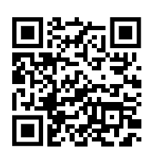
Use of Artificial Intelligence in Teaching
Rules and recommendations regarding AI can be found under good practices:
https://oigusaktid.taltech.ee/en/academic-policies/
Permitted uses:
As a source of inspiration
For evaluating and refining your own thoughts and ideas
For translation and learning support in early stages of work
For text editing in the final stage of work
Prohibited uses:
For composing large portions of thesis text
For fabricating data to be analyzed in the work
For composing substantive arguments
Üliõpilane vastutab lõputöö sisu ja kvaliteedi eest, sõltumata kasutatud allikatest, sh tehisintellekt.
The student is responsible for the content and quality of the thesis, regardless of the sources used, including artificial intelligence.
TALLINNA TEHNIKAÜLIKOOL
Notes:
Let’s review the fundamentals.
The university has centrally established good practices for using AI.
From this link (please open on your mobile), you can see all the good practices.
Select “Guidelines for Using Artificial Intelligence in Teaching.”
In summary, there are general agreements on how to use AI correctly.
In all actions involving AI, the responsible party is the human. “AI did it” is not acceptable. AI does nothing independently – a person used it, therefore the person is responsible.
Next, I will explain how I have planned the use of AI in my course [insert course name].

Slide 3
AI Usage Rules (Course)
Add AI usage rules to your course’s extended syllabus.
Explain how AI is generally allowed in your course. Provide examples of both permitted and prohibited uses.
Show students the extended syllabus where you have written out the AI rules.
NB! If you have defined different AI usage rules for each assignment, inform students where they can find this information (e.g., in the assignment description)., siis teavitage õppijaid, kuskohast nad vastava info saavad (nt. ülesande juures)
Notes:
Let’s review where help is available and who decides how AI is used at the university.
The exact use of AI in your course is decided by the lecturer.
So pay close attention to what your program directors and lecturers say about AI usage.
Lecturers decide how much and in what way AI is allowed in their course.
You’ll find this information in the extended course description or in specific rules for each assignment. Please follow these rules.
In addition to lecturers, program directors, potential thesis supervisors, and the created e-course, our knowledgeable library specialists also offer help.
They know and advise you on how to write the best thesis or find the best academic sources.
We have planned trainings in November on how to use AI in theses.
If you need help earlier, participate in consultations or other courses offered by the library.
The university has also created a central e-course to help students, which provides an overview of:
What AI is
How to prompt better
Examples of different apps used in teaching
What is good and bad AI usage
AI ethics and each person’s responsibility in using it
Have you already opened and completed it?
If not, you can open it via this QR code and plan to complete it by September – the earlier, the better.
Without this course, you may fall behind your peers who already have knowledge about using AI.

Slide 4
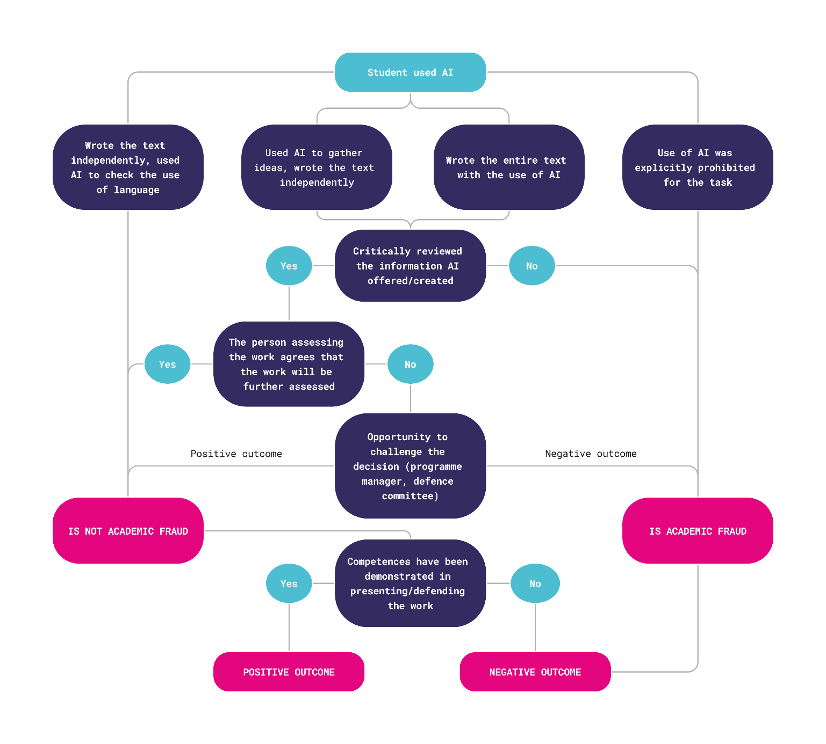
Artificial Intelligence Usage – Allowed or Prohibited?
Here is a diagram that simplifies understanding whether AI is allowed or not.
Case 1:
Case 2:
Notes:
The university has created a block diagram to help answer various questions about whether AI usage is allowed.
It is very important to find out what the evaluator (e.g., lecturer) has allowed.
If no restrictions are mentioned, you cannot assume AI usage is allowed. In that case, ask the lecturer.
Although the university allows AI for idea generation and language improvement, usage must always be clarified in the context of the specific course.
Provide two examples of how AI can be used in your course and what would be considered academically inappropriate usage in your view.
Ask: Does anyone have an example of a case we could try to solve using this diagram to determine whether it is allowed in our course?

Slide 5
What Happens If a Student Is Caught Cheating or Overusing AI?
The student is responsible for following academic good practices.
Violations of academic integrity include: plagiarism, submitting AI-generated work without permission, presenting false data, submitting someone else’s work under your own name.
Consequences for the student may include:
Unsatisfactory grade
Prohibition from resubmitting the work
Expulsion for repeated or severe violations
A note of academic dishonesty as a reprimand
The student is obligated to familiarize themselves with and follow the lecturer’s, course’s, and university’s academic integrity principles, including the permitted extent of AI usage.
The lecturer is responsible for giving clear instructions:
What is allowed and what is not (e.g., whether AI may be used and in which parts), what are the requirements for submitting and citing work
For guiding the student to understand the boundaries of academic integrity and AI usage
For monitoring compliance with rules, including:
  Detecting suspicious work (plagiarism detection, other academic violations), documenting violations, and initiating reprimands if necessary
The lecturer may conduct additional checks to verify acquired competencies – e.g., ask to redo the work in class, ask for oral explanations of the topic
Notes:
It is very important that we all understand our rights and responsibilities in our work – you as students and me as a lecturer.
All lecturers expect that you have come to university to learn and truly acquire competencies.
If learning becomes difficult, I am here to help make it easier together.
AI may help in difficult situations, but quite often it can cause harm – the brain becomes lazy and learning no longer occurs.
At university, you must learn independently and prove it.
Therefore, we must also talk about situations where academic good practice has been violated and punishment follows.
In my course, punishment includes [insert examples].
At the university level, severe cases may result in reprimand or expulsion.
So it is very important that when I conduct assessments, they are based on your actual work and acquired competencies.
It is completely normal that, in addition to submitted work, I conduct random checks where I ask you to explain or redo your work, for example, in class.
My goal is that every course graduate has acquired the required competencies independently and can demonstrate them.
Each student’s journey to acquiring and proving competencies may be different – this means we have central assignments and assessments, but for clarity, additional checks may be added where you can explain and show that you truly have the required competency.
This is completely normal and does not require special attention – if you have the skills, there is no problem in proving them.

Slide 6
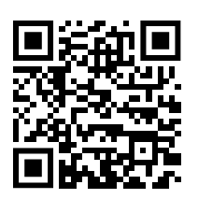
AI Support and Course for Students
Academic use of AI is also explained by library specialists: https://taltech.ee/en/library
In November, the library hosts “Thesis Week.”
A supporting e-course for students is available (currently EST) https://moodle.taltech.ee/course/view.php?id=35369
Notes:
To conclude, let’s review where help is available and who decides whether AI usage is allowed or not.
The university has also created a central e-course to help students, which provides an overview of:
What AI is
How to prompt better
Examples of different apps used in teaching
What is good and bad AI usage
AI ethics and each person’s responsibility in using it
Have you already opened and completed it?
If not, you can open it via this QR code and plan to complete it by September – the earlier, the better.
Without this course, you may fall behind your peers who already have knowledge about using AI.
In addition, our knowledgeable library specialists also offer help.
They know and advise you on how to write the best thesis or find the best academic sources.
We have planned courses and events in November on how to use AI in theses.
If you need help earlier, participate in consultations or other courses offered by the library.

